Slide 1
Colourful Semantics – Learning from home
The following slideshow is used to assist with students learning the colourful semantics program.
Click ‘view slideshow’
Students will select the correct visual and it will slide into place

Slide 2
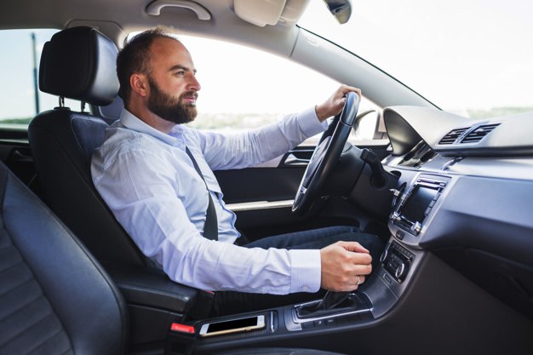
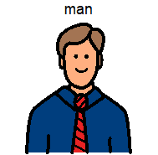
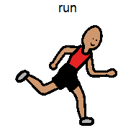
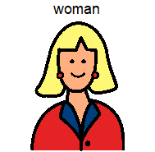
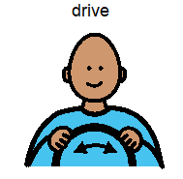

Slide 3
The man is driving.

Slide 4
Who is driving?

Slide 5
What is he doing?

Slide 6
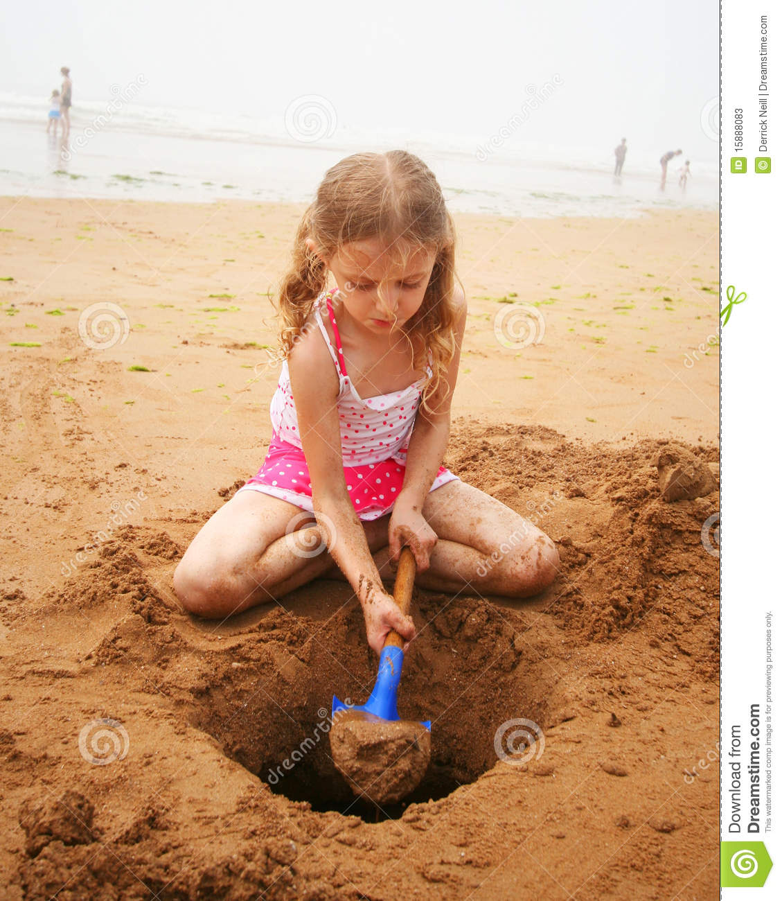
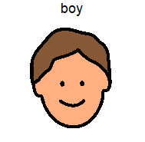
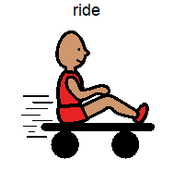

Slide 7
The girl is digging.

Slide 8
Who is digging?

Slide 9
What is she doing?

Slide 10
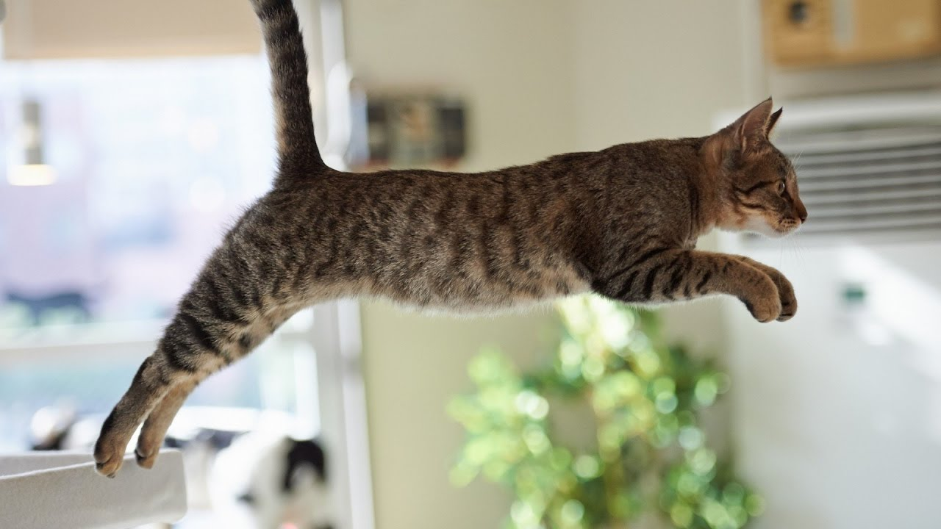
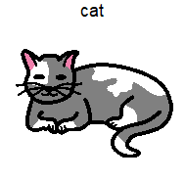
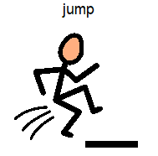

Slide 11
The cat is jumping.

Slide 12
What is jumping?

Slide 13
What is the cat doing?

Slide 14
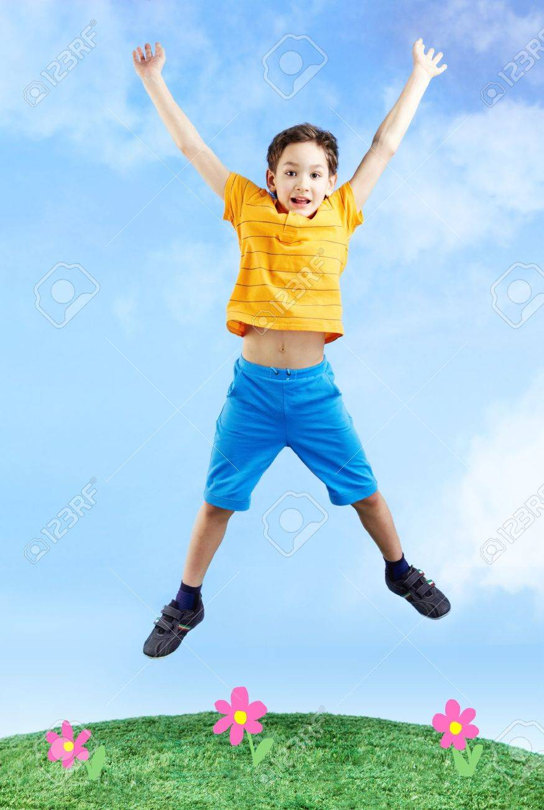
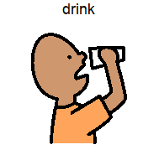

Slide 15
The boy is jumping.

Slide 16
Who is jumping?

Slide 17
What is he doing?

Slide 18
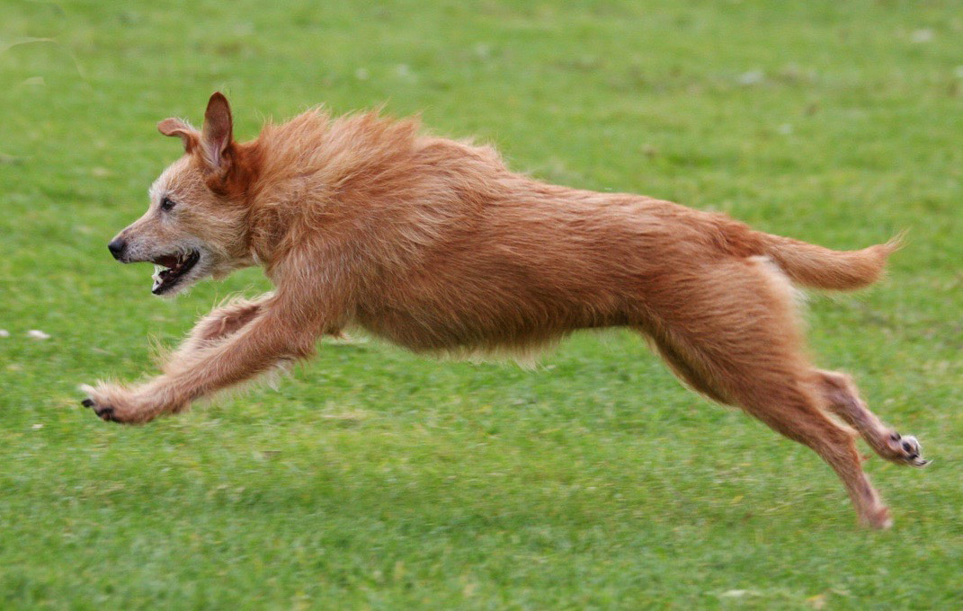

Slide 19
The dog is running.

Slide 20
What is running?

Slide 21
What is the dog doing?

Slide 22
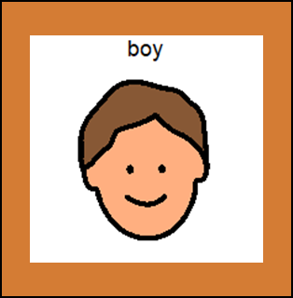
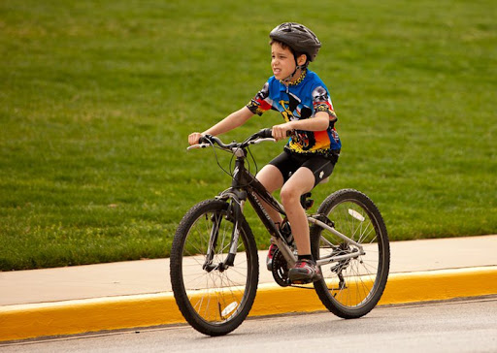

Slide 23
The boy is riding.

Slide 24
Who is riding?

Slide 25
What is he doing?

Slide 26
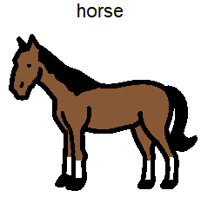
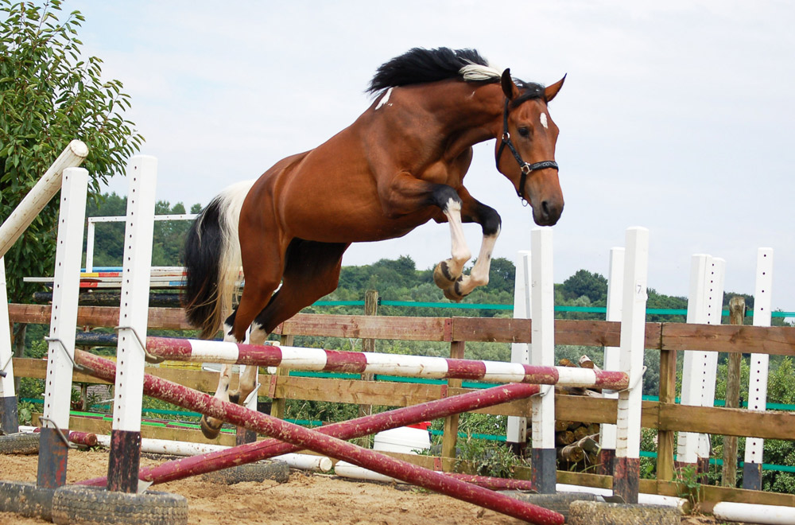

Slide 27
The horse is jumping.

Slide 28
What is jumping?

Slide 29
What is the horse doing?

Slide 30
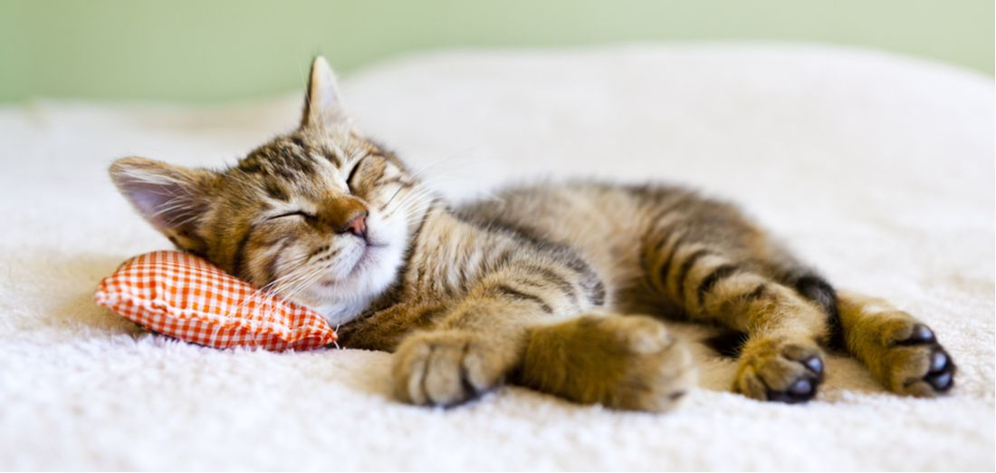

Slide 31
The cat is sleeping.

Slide 32
What is the cat doing?

Slide 33
What is sleeping?

Slide 34
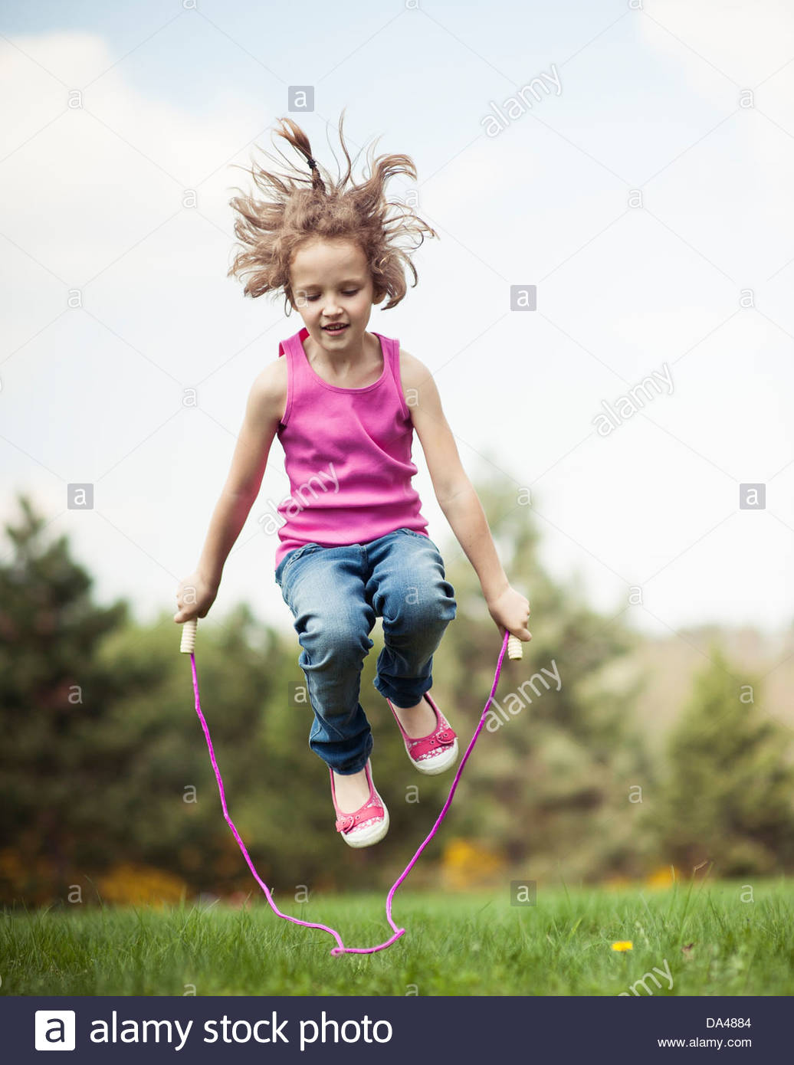
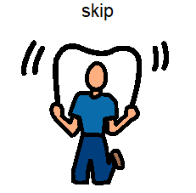

Slide 35
The girl is skipping.

Slide 36
What is she doing?

Slide 37
Who is skipping?

Slide 38
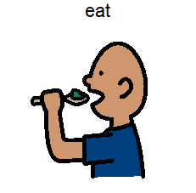
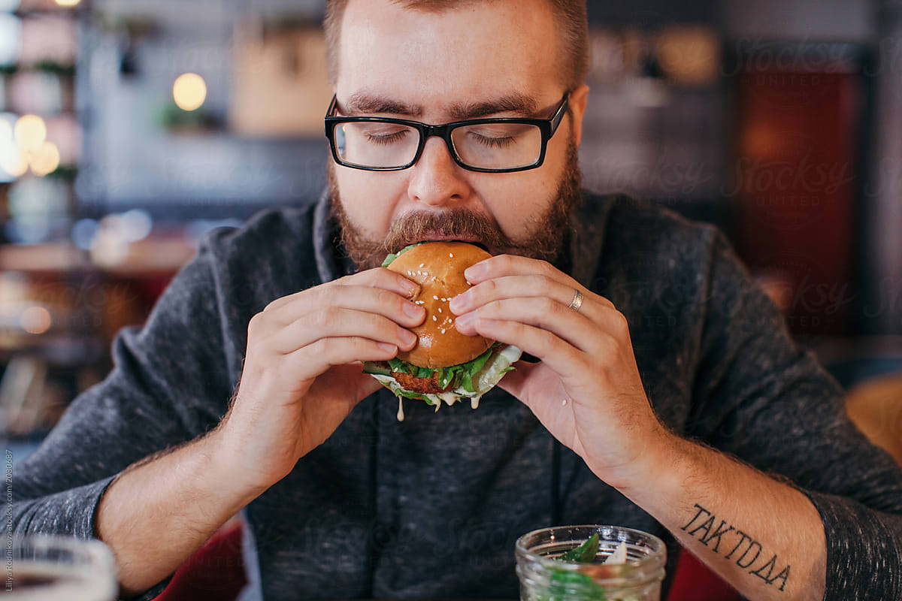

Slide 39
The man is eating.

Slide 40
What is he doing?

Slide 41
Who is eating?

Slide 42
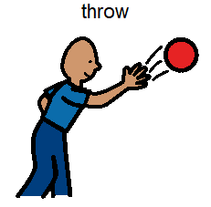
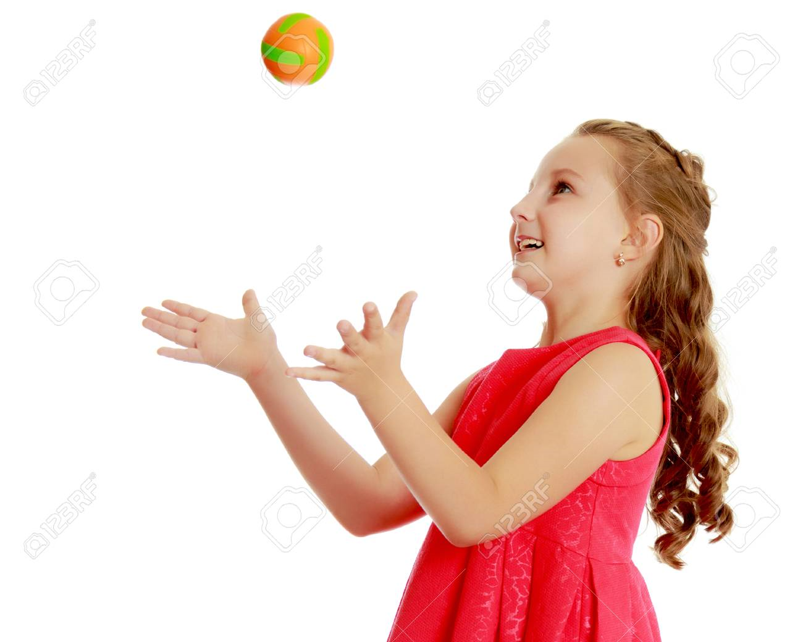

Slide 43
The girl is throwing.

Slide 44
What is the girl doing?

Slide 45
Who is throwing?

